Slide 1





Analysis Factors that Affecting Students Performance in Exams
Creator
Christian Gavriel Emanuel Hariyadi - linkedin.com/in/christiangavriel/

Slide 2
Analysis Factors that Affecting Students Performance in Exams
Analysis Objective
This project analyzes the Student Performance dataset to identify key demographic, educational, and behavioral factors influencing students average exam scores. Using data cleaning, statistical methods, and AI-assisted analysis, it reveals patterns and insights to help improve student outcomes.
Three Key Analysis Points:
Parental Level of Education
Test Preparation Course Completion
Race/Ethnicity and Test Preparation Status
Tools
Dataset
Google Collab
StudentsPerformance.csv (1000 student records)

Slide 3
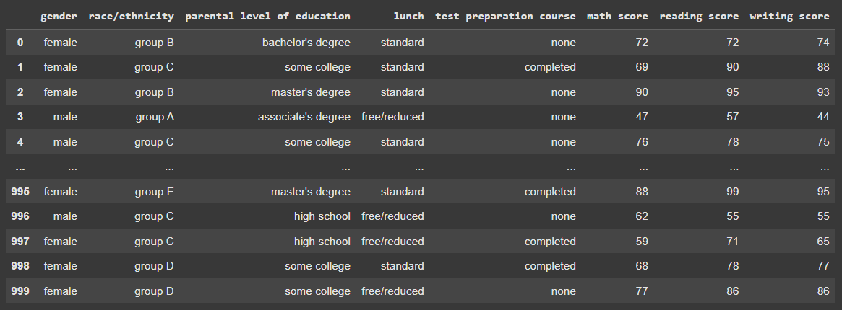




Dataset

Slide 4
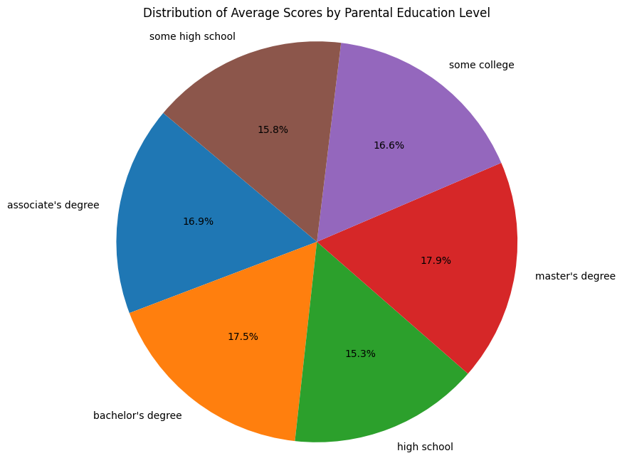
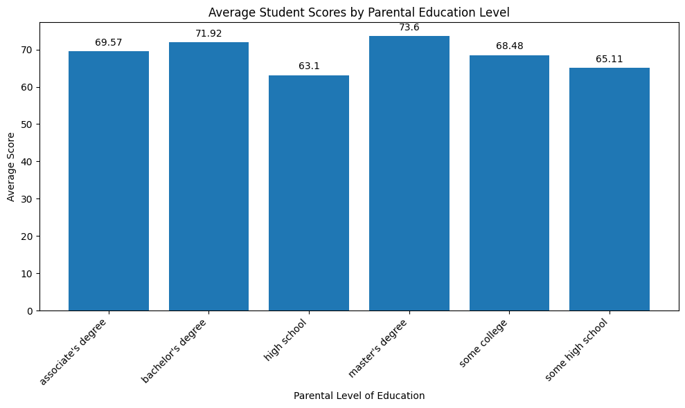
Analysis 1:
The Influence of Parental Level of Education

Slide 5
Analysis 1:
The Influence of Parental Level of Education
There is a clear trend that the higher the parental level of education, the higher the average scores achieved by students.
Students whose parents hold a master's degree (average 73.60) and a bachelor's degree (average 71.92) show the best performance.
Conclusion :
Family educational background is a significant factor in students academic success. This could be due to encouragement, better resources, or a more supportive learning environment at home.

Slide 6
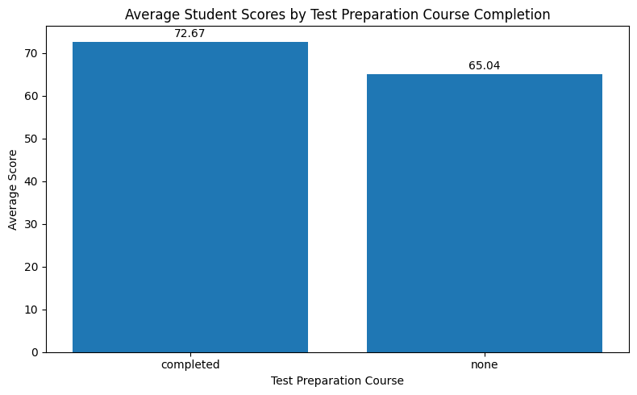
Analysis 2:
The Influence of Test Preparation Courses

Slide 7
Analysis 2:
The Influence of Test Preparation Courses
Students who completed the test preparation course have a much higher average score (72.67) compared to students who did not take the course (65.04).
The difference in average scores is over 7 points, indicating the effectiveness of additional preparation.
Conclusion :
Structured study and preparation have a direct and positive impact on student test results.

Slide 8
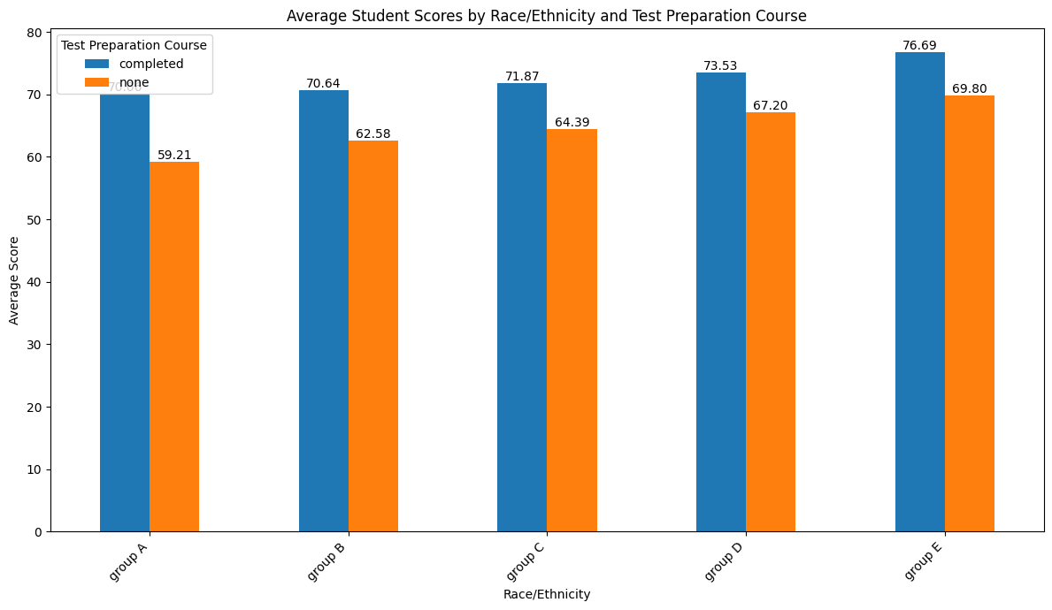
Analysis 3:
Analysis by Race/Ethnicity & Test Preparation

Slide 9
Analysis 3:
Analysis by Race/Ethnicity & Test Preparation
In all ethnic groups, students who completed the preparation course (completed) always scored higher than those who did not (none).
However, a baseline performance difference between groups is evident. Group E consistently has the highest average scores, regardless of course completion. Conversely, Group A has the lowest scores.
Conclusion :
Although test preparation helps all students, other external factors related to ethnic background also influence academic performance. Improvement and additional support are needed for some groups to prevent the gap from widening.

Slide 10
Conclusion & Recommendations
Student academic performance is strongly influenced by a combination of individual preparation and family background. Completing a test preparation course provides a significant and uniform boost to scores across all student groups, while a higher level of parental education also correlates strongly with better student outcomes. However, the analysis also reveals that a persistent performance gap exists among different ethnic groups, even when accounting for test preparation. This suggests that while individual effort and home environment are key drivers, systemic factors also play a critical role and require targeted interventions to ensure equitable success for all students.
Recommendations:
Promote and facilitate access to test preparation courses for all students.
Develop programs that foster parental involvement in their childrens education.
Conduct further research to identify and address the root causes of performance gaps between ethnic groups.

Slide 11
AI Support Explanation
This analysis is supported by the IBM Granite Large Language Model (LLM), accessed through the Replicate API and integrated with LangChain. The model is used not only to provide automatic insights for each individual data row, such as assessing usefulness and generating clear explanations, but also to act as an intelligent assistant for data manipulation tasks. By creating a Pandas DataFrame agent, the model can rapidly execute operations like removing missing values, dropping duplicate records, and performing other routine preprocessing steps. In this way, the AI component helps accelerate both the exploratory and cleaning phases of the analysis, allowing the focus to shift toward interpreting results and identifying meaningful patterns in the dataset.

Slide 12




Thank You

